Slide 1

Professor David Flynn
More Functions & Objects - EN2083

Slide 2





More Functions & Objects
Car Class
Many functions will exist already
- They may exist as toolboxes created by other programmers
- However, many are simple and you can create by yourself
Car Colour
Red
Grey
White
Objects
Car Company
Porsche
Citreon
Tesla
Model
Boxter
Picasso
Model S

Slide 3
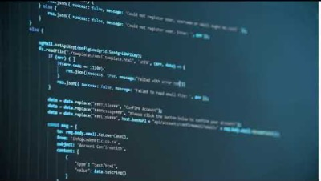
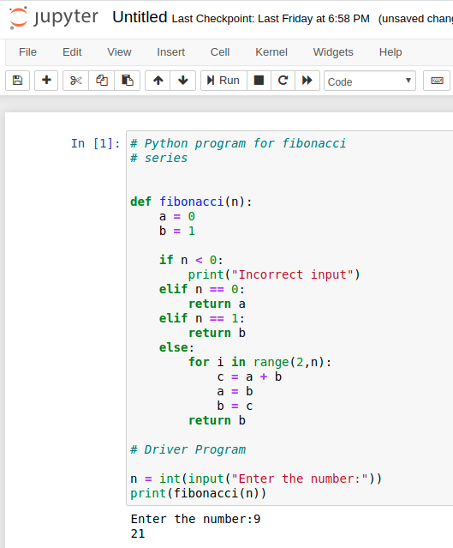
writing functions
  now we need to know how to write our own !

Slide 4
Reminder
in general functions are defined :
    def func_name(arguement, arguement,…):
        """Text Description."""
        declarations_of_local_variables
        statements
        return expression #optional
for example :
    def cat_age(human_age):
        """Translate human to cat ages."""
        multiplier = 4
        if (human_age==1): return 15
        if (human_age==2): return 24
        return human_age*multiplier + 16
Notes:
Idea of functions hiding previous work to simplify code should be introduced here.

Slide 5
Functions - calling
functions are defined before use, and then called by :
    ...
    my_age = 46
    cat_age(12) # pointless, ignores answer
    felix_age = cat_age(4) # felix_age now 32
    print(cat_age(12) # output ancient!
    ...
but of course everything is always more complex than you initially think!

Slide 6

Functions – calling – In class example
How many students are in this lecture theatre? We can create a class for students favourite colours.
Step 1: Create dataset E.g. ‘Dan_Colour=Blue’, ‘Amy_Colour=Green’ etc
Step 2: You could create a function to count favourite colours and name these ‘1st’, ‘2nd’ and ‘3rd’
Step 3: Then you could use the calling function to automatically print the top 3 favourites
How would we do it?
Step 1?
Step 2?
Step 3?

Slide 7
Multiple function inputs
best by example :
    def max(a, b):
        """Print the maximum of a, b."""
        if (a>b):
        print(a)
        else:
        print(b)
called by :
    max(3,4) # with literals, prints 4
    fred, anne = 7,6
    max(fred, anne) # with variables, prints 7

Slide 8

Positional inputs
best by example :
    def max(a, b):
        """Print the maximum of a, b."""
        if (a>b):
        print(a)
        else:
        print(b)
called by :
    max(3,4) # with literals, prints 4
    fred, anne = 7,6
    max(fred, anne) # with variables, prints 7
Have to remember order

Slide 9


Keyword inputs
best by example :
    def max(a, b):
        """Print the maximum of a, b."""
        if (a>b):
        print(a)
        else:
        print(b)
called by :
    max(b=3,a=4) # with literals, prints 4
    fred, anne = 7,6
    max(a=fred, b=anne) # with variables, prints 7
Have to remember keywords

Slide 10
Default inputs
best by example :
    def max(a, b=100):
        """Print the maximum of a, b, badly."""
        if (a>b): print(a)
        else: print(b)
called by :
    max(3,4) # with literals, prints 4
    fred = 7
    max(fred) # with variable, prints 100 fred->a
    max(a=7,b=3) # with literals, prints 7
    max(b=10) # error, b->10, but a undefined

Slide 11
better default example
    def ask(prompt, retries=4, reminder='try again!'):
    while True:
    ok = input(prompt)
    if ok in ('y','yes'):
    return True
    if ok in ('n', 'no'):
    return False
    retries = retries - 1
    if retries < 0: print('arghh!')
    print(reminder)
called by :
    ask("want a quiz?") # both defaults used
    ask("should I erase?", 3) # default reminder only
    ask("should I erase?", 2, "response PLEASE!")

Slide 12
Avoid changing inputs
best by example - only the value of x passes:
    x = 10
    def tweak(a):
        """Print then tweak then print."""
        print(a)
        a = 20; print (a)
once inside you are in a different scope:
    tweak(x)
    print(x)
    # printed result is 10 (inside), then 20 (inside),
    # then 10 (outside, unchanged)

Slide 13
function outputs
every function (just like in maths) returns one thing, using the return statement:
    def addition(a, b):
        """Is there a duller function?."""
        return a+b
    sum = addition(3,7) # usage is dull too
even if you don't return, you actually do, you return with a value of None.

Slide 14
function outputs
but what if I need to return more than one thing?
    def add_sub(a, b):
        """Still a dull function."""
        return a+b, a-b # return a tuple
    sum, difference = add_sub(3,7) # get back tuple
just return a tuple, list or dictionary!
Usually the purpose of the function will suggest which one is best.

Slide 15
Documentation strings
all functions can have text as their first line.
this can be a one line, or multiple lines
def some_random_function():
"""Capital start, brief description, endstop.
After blank line, more detailed descriptions can go on for as many lines as you want"""
convention - Python uses these as documentation, and the help() function fetches them.

Slide 16
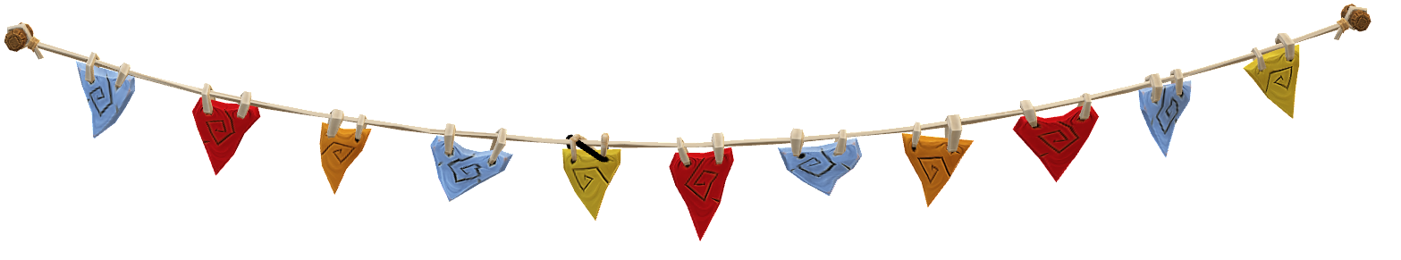
IMPORTANT - STRINGS
Strings are different to floats and integars etc.
When you receive a string. This is simply a list of characters in a row.
Take this piece of string… Each flag represents a character but we need to tell the code what to do with each character
To us we can see what it says 😎, but the code needs help in figuring it out
D
8
A
G
R
N
I
S
E
L
I

Slide 17
You can also break down strings to make sense of what is going on
This is where delimiters are useful
This may be spaces or commas in datasets
to identify words
Daniel,Is,Gr8=Daniel Is Gr8
D
8,
A
G
R
N
I
S,
E
L,
I

Slide 18
Strings can get very long though…
2023-10-23 00:00:00, 20.5 2023-10-23 00:30:00, 20.3 2023-10-23 01:00:00, 20.1 2023-10-23 01:30:00, 20.0 2023-10-23 02:00:00, 19.8 2023-10-23 02:30:00, 19.7 2023-10-23 03:00:00, 19.6 2023-10-23 03:30:00, 19.4 2023-10-23 04:00:00, 19.3 2023-10-23 04:30:00, 19.2 2023-10-23 05:00:00, 19.1 2023-10-23 05:30:00, 19.0 2023-10-23 06:00:00, 18.9 2023-10-23 06:30:00, 18.8 2023-10-23 07:00:00, 18.7 2023-10-23 07:30:00, 18.6 2023-10-23 08:00:00, 18.6 2023-10-23 08:30:00, 18.5 2023-10-23 09:00:00, 18.5 2023-10-23 09:30:00, 18.4 2023-10-23 10:00:00, 18.4 2023-10-23 10:30:00, 18.3 2023-10-23 11:00:00, 18.3 2023-10-23 11:30:00, 18.3 2023-10-23 12:00:00, 18.2 2023-10-23 12:30:00, 18.2 2023-10-23 13:00:00, 18.2 2023-10-23 13:30:00, 18.2 2023-10-23 14:00:00, 18.2 2023-10-23 14:30:00, 18.2 2023-10-23 15:00:00, 18.2 2023-10-23 15:30:00, 18.2 2023-10-23 16:00:00, 18.2 2023-10-23 16:30:00, 18.2 2023-10-23 17:00:00, 18.3 2023-10-23 17:30:00, 18.3 2023-10-23 18:00:00, 18.4 2023-10-23 18:30:00, 18.4 2023-10-23 19:00:00, 18.5 2023-10-23 19:30:00, 18.6 2023-10-23 20:00:00, 18.7 2023-10-23 20:30:00, 18.8 2023-10-23 21:00:00, 19.0 2023-10-23 21:30:00, 19.1 2023-10-23 22:00:00, 19.2 2023-10-23 22:30:00, 19.3 2023-10-23 23:00:00, 19.4 2023-10-23 23:30:00, 19.5
Any ideas what this dataset could be for?

Slide 19

Makes more sense now?
Timestamp, Temperature (°C)
2023-10-23 00:00:00, 20.5
2023-10-23 00:30:00, 20.3
2023-10-23 01:00:00, 20.1
2023-10-23 01:30:00, 20.0
Dataset for house temperature for every 30 minutes…
But we can understand the previous data set by counting delimiters or
even by identifying the timestamp and then the temperature

Slide 20
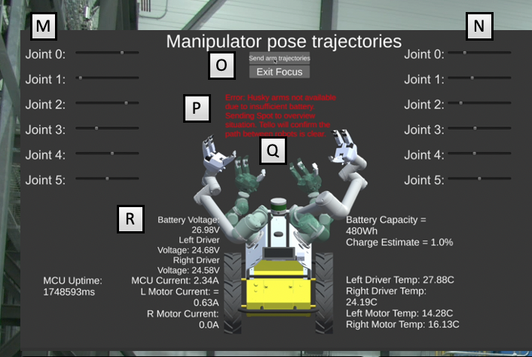
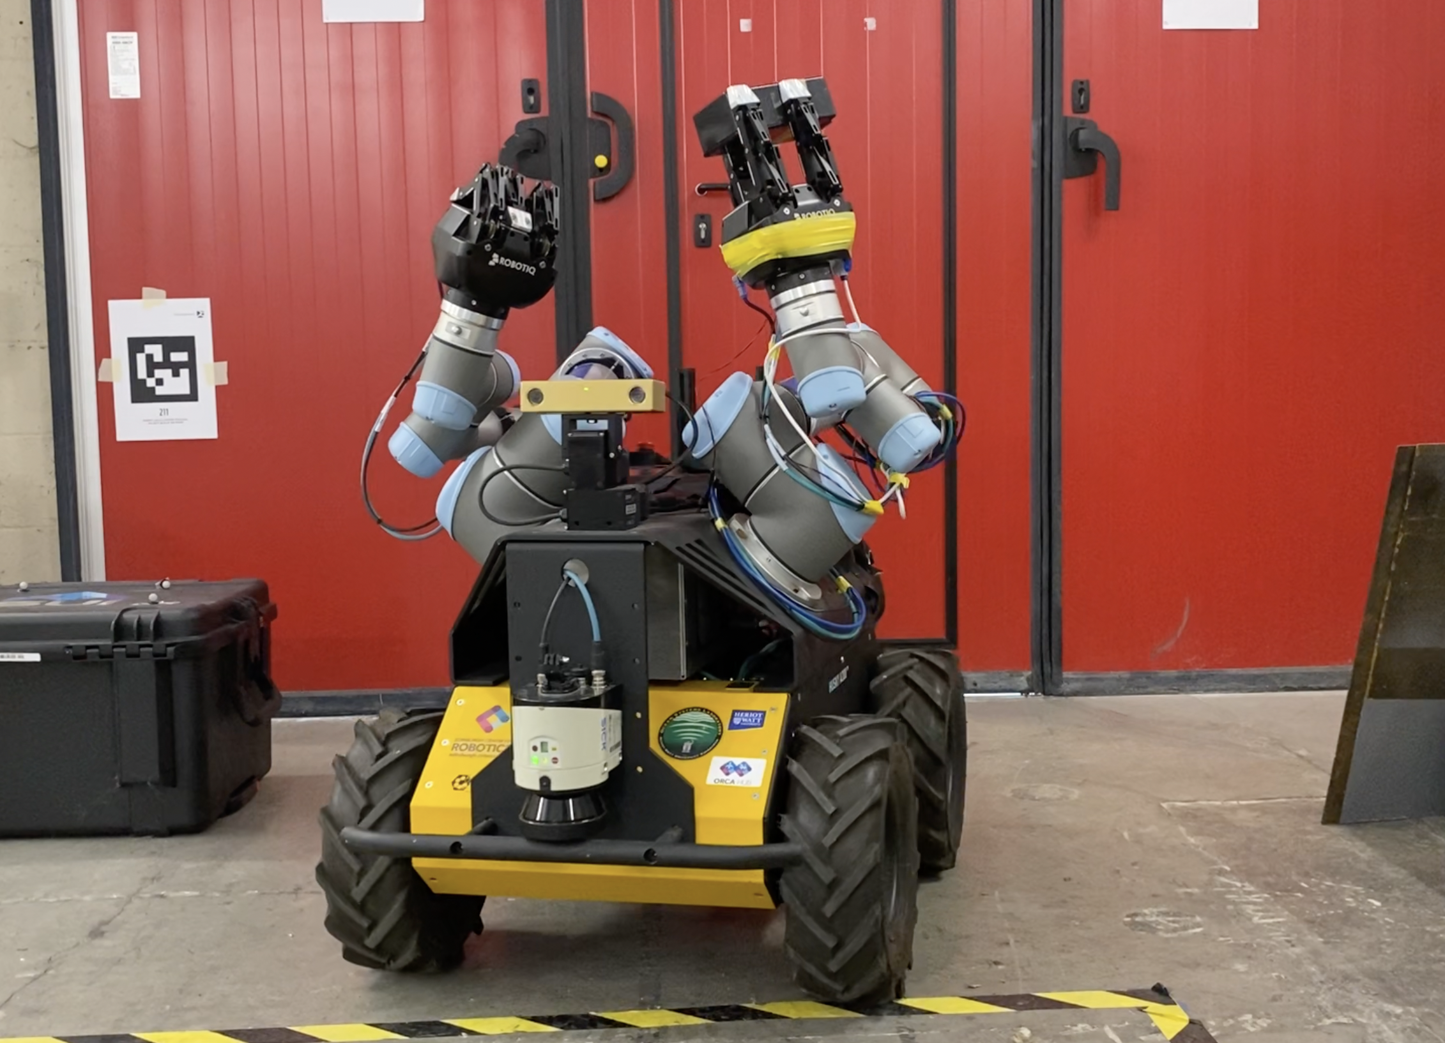
Strings Example
How do we collect data from a real robot?
Cyber Physical Systems
Physical Robot
Cyber Robot
A. Diagnostic Data from Husky looks like this:
26.98 24.68 24.58 2.34 0.63 0.0 480 1.0 27.88 14.28 16.13
This is a string of numbers which have not been organized…
B. For the Cyber interface to understand the we can program the dashboard to identify ‘spaces’
within the string and organize them with the correct variable name…
C. Every time the Husky robot sends data to the dashboard it sends the string in the same order
of variables.
D. In the digital dashboard we act as the translator to identify the string, detect the number,
give it a variable and provide it to the human. This is Robotic language translated to human language
Battery Voltage = 26.98V
Left Driver Voltage = 24.68V
Right Driver Voltage = 24.58V

Slide 21
additional functionality
stuff that turns out to be useful or important - but probably won't look useful until you need it...

Slide 22
Lists as input
I can just as well have a list as an input.
    def greeting(names):
    """Say hello to everyone."""
    for name in names: # loop through list
    print("Hello "+ name + "!")
    people = ['fred', 'anna', 'bob']
    greeting(people)
and this works just fine, get
Hello fred!
Hello anna!
Hello bob!
Out[44]:

Slide 23
lists as input
However, the list is mutable, can be changed.
    def greeting(names):
    """Say hello to everyone."""
    for name in names: # loop through list
    print("Hello "+ name + "!")
    names[0] = 'frederick' # naughty, naughty
    people = ['fred', 'anna', 'bob']
    greeting(people)
still prints as before, but now...
# people = ['frederick', 'anna', 'bob'] OUTSIDE !

Slide 24
lists as input
If you don't want to change list send a copy.
    def greeting(names):
    """Say hello to everyone."""
    for name in names: # loop through list
    print("Hello "+ name + "!")
    names[0] = 'frederick' # naughty, naughty
    people = ['fred', 'anna', 'bob']
    greeting(people[:]) # makes copy of whole list
so people is unchanged. (you often want the list altered, which is why that's the default)

Slide 25

tuple as final input
sometimes you might have a variable number of inputs to a function - by habit called args.
    def concat(*args, sep="/"): # anything after *args
    return sep.join(args) # must be keyword
    concat("earth", "mars", "venus")
    # = 'earth/mars/venus'
    concat("earth", "mars", "venus", sep=".")
    # = 'earth.mars.venus'
args will alway be a tuple, and often the last arguement (no positional arguments after!)

Slide 26
Dictionary as input
and you can also supply a dictionary of keyword-ed arguments using the following:.
    def dull(**keywords): # must be last
    for kw in keywords:
    print(kw, " : ", keywords[kw])
    dull(planet="earth",satellite="moon",star= "sol")
    # prints
    # planet : earth
    # satellite : moon
    # star : sol
but I've rarely used this, if ever.

Slide 27
  Object Oriented Programming
now we get to write some classes 🙂

Slide 28
recap
everything is an object (i.e. variables on steroids; rich and talkable to)
a program is a bunch of objects talking (a message is pretty much a function call)
each object has its own hidden guts (containing variables, which are objects!)

Slide 29
Recap structure...
definition :
    class Car():
        """Model a Car."""
        def __init__(self, make, model):
        """Initialise"""
        self.make = make
        self.model = model
        self.tank_cap = 60 #60 litre tank
        self.tank = 0 #initial fuel fill
        def fillup(self):
        """fill tank to brim"""
        self.tank = self.tank_cap
        print("Full!")
        def ... #other functions and private vars

Slide 30
Recap structure...
use - much, much easier than definition! :
    myCar = Car('nissan', 'micra')
    print(myCar.make)
    print(myCar.model)
    myCar.fillup()
of course, it is still possible to muck up:
    myOtherCar = Car('nissan', 'leaf')
    print(myOtherCar.make)
    print(myOtherCar.model)
    myOtherCar.fillup()

Slide 31
Classes / Objects
a 'type' (like a float) just describes a variable which can contain a number. You then need to bring the variable into existence.
    myHeight = 2.0
a 'Class' just describes an Object which can contain data and functions. You then need to bring the Object into existence.
    class Car():
        """Model a Car."""
    myCar = Car('nissan', 'micra')

Slide 32

Classes / Objects
functions acting on the object are described in the Class, and refer to object 'themselves'
    class Car():
        """Model a Car."""
        ...
        def fillup(self):
        """fill tank to brim"""
        self.tank = self.tank_cap
        print("Full!")
and then the objects can have the functions applied to them - self becomes myCar
    myCar = Car('nissan', 'micra')
    myCar.fillup()
    myCar = Car('nissan', 'micra')
called a Method

Slide 33

Classes / Objects
data about each object is described in the Class, again referring to the object 'itself'
    class Car():
        """Model a Car."""
        def __init__(self, make, model):
        """Initialise"""
        self.make = make
        self.model = model
and then the objects can access that data
    myCar = Car('nissan', 'micra')
    print(myCar.make)
data local to each object

Slide 34


Classes / Objects
it is possible to also define data common to all objects of a class.
    class Car():
        """Model a Car."""
        fuel_type = 'petrol'
        def __init__(self, make, model):
        """Initialise"""
        self.make = make
        self.model = model
and then the objects can access that data
    myCar = Car('nissan', 'micra')
    print(myCar.make)
    print(myCar.fuel_type)
    print(Car.fuel_type) #since it's a class variable
every object will get petrol
data local to each object

Slide 35

Classes / Objects
this can be used in more interesting ways than just defining 'constants'.
    class Car():
        """Model a Car."""
        numberCars = 0
        def __init__(self, make, model):
        """Initialise"""
        self.make = make
        self.model = model
        Car.numberCars +=1
and then the objects can access that data
    print(Car.numberCars) # zero
    myCar = Car('nissan', 'micra')
    print(Car.numberCars) # one
Class variable
everyone gets
I update everyone

Slide 36
Constructor
in classes, there is a function, __init__, which you write, automatically called when an object is created - the constructor.
It sets up the initial variables of the object, either itself, or from data supplied
        def __init__(self, make, model):
        """Initialise"""
        self.make = make
        self.model = model
        self.tank_cap = 60 #60 litre tank
        self.tank = 0 #initial fuel fill

Slide 37
Modifying attributes
in python, object data are easily accessible.
    myCar = Car('nissan', 'micra')
    print(myCar.tank) # get fuel level
    myCar.tank = myCar.tank + 5 # put in some fuel
but it is best to write a function / method to change the data more safely
        def add_fuel(self, amount):
        """Adding fuel to tank"""
        if (self.tank+ amount <= self.tank_cap
        self.tank = self.tank + amount
        else:
        print("Tank not big enough")

Slide 38
Class methods
if you want a function to muck around with class data at class level (not object level)
    class Car():
    numberCars = 0
    def __init__(self, make, model):
    self.make = make
    self.model = model
    Car.numberCars +=1
    @classmethod
    def how_many(cls): # 'self' for classes
    print("{}".format(cls.numberCars))
call with
    Car.how_many() # gives 0 before objects created
    myCar.how_many() # can't use until myCar exists

Slide 39
factory functions
you can only have one __init__ function in a class, but if you want special initialisation,
    class Pizza:
    def __init__(self, ingredients):
    self.ingredients = ingredients
    def __repr__(self): # go investigate :)
    return f'Pizza({self.ingredients!r})'
    # f strings for compactness
    @classmethod
    def margherita(cls):
    return cls(['moz', 'tomatoes'])
    myCheese = Pizza(['cheese', 'cheese'])
    print(myCheese) # Pizza(['cheese', 'cheese'])
    myOtherPizza = Pizza.margherita()
    print(myOtherPizza) # Pizza(['moz', 'tomatoes'])

Slide 40
Inheritance
Trash
weight value
shred() burn()
Start from a base/super/parent type/class.
Invent a new class, initially cloned from the base: an inherited/sub/child/derived class.
Add new data and functions
to the derived class, and
override functions of base.
Wastepaper
condition value_wet value_dry
value_refresh()
Can
crush()

Slide 41
Inheritance
Trash
weight value
shred() burn() crush()
The balance of what goes in the base class and how the derived classes augment, is the tricky design bit.
Can decide only to override
(a Can is a Trash)
If you add stuff to the child
it can do more (Waste
paper is like Trash)
Wastepaper
condition value_wet value_dry
value_refresh()
Can
crush()

Slide 42
Inheritance
Trash
weight value
shred() burn() crush()
If you are writing code,...
doStuff(x)
...
x.crush() ...
this, amazingly, works !
Trash t; Wastepaper w; Can c;
doStuff(t) #base crush
doStuff(w) #base crush
doStuff(c) #specialised crush
Wastepaper
condition value_wet value_dry
value_refresh()
Can
crush()

Slide 43
inheritance in cars
class picks up Car, gets all data/methods :
    class ElectricCar(Car):
        """Model an electric Car."""
        def __init__(self, make, model):
        """Initialise electric car"""
        super().__init__(make, model):
        self.battery_cap = 30 #30 kWh battery
        self.charge = 0 #initial charge
        def charge(self):
        """Fully charge battery"""
        self.charge = self.battery_cap
        print("Full!")
        def ... #other functions and private vars
adds data and methods of own !

Slide 44
Inheritance in cars
so can do all that the previous objects can do :
        myOtherCar = ElectricCar('nissan', 'leaf')
        print(myOtherCar.make)
        print(myOtherCar.model)
plus !
        myOtherCar.charge() # this bit added in class
        myOtherCar.fillup() # oops, still works !
        print(myOtherCar.fuel_type) #still petrol

Slide 45
inheritance in cars
so need to override methods from parent class :
        def fillup(self):
        """Not on an electric car."""
        print("No fuel tank!")
        )
and need to override data from parent class !
        fuel_type = 'electricity'

Slide 46
other classy info
the data that a class defines, and which are therefore properties of objects, can be classes themselves.
a car Class, and all the Car objects instantiated from it can contain data which are themselves objects (indeed in python, all the strings and numbers already are)
you can of course have Lists of Cars, and Dictionaries with keyword, Car pairs !

Slide 47
other classy info
Classes are great, but you end up with large text files of code. Usually these are stored separately as .py modules.
So then you can do :
        from car import Car, ElectricCar
or :
        import car # file saved as car.py
to import the module and start using the objects therein.

Slide 48
More on inheritance
You've already seen this,
but just to give extra insight

Slide 49
Recap - Inheritance
Think of the phrase 'is a'
So a pigeon is a bird. So the base/super/parent class is the bird and the inherited/sub/child/derived class is a pigeon.
a pigeon can access all the data types and employ all the functions of a bird.
Be careful - for instance flight is not for all

Slide 50
Recap - Inheritance
Not all birds fly.
So the base might be a bird (wings, flapping)
And a subclass might be a non-flightless bird (add airspeed, levitation)
And a sub-subclass could be a pigeon. (add dirt, annoying commuters)

Slide 51
What Inheritance isn't
Just flag another sort of relationship 'has a'
A car has an engine, wheels, seats, ...
The car class does not 'inherit' in the same way we have been discussing.
But as explained, we can make a car class with data which are themselves objects of class engine, ...

Slide 52



Thank you
#UofGWorldChangers
@UofGlasgow

